Slide 1
GraphQL Schema Validation
How to make sure you don’t break stuff on the client and the server

Slide 2
GraphQL gives us the power to easily validate our APIs.

Slide 3
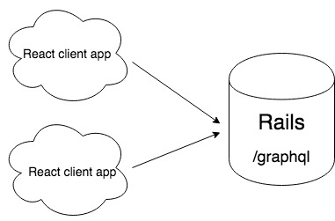
ezCater app architecture

Slide 4
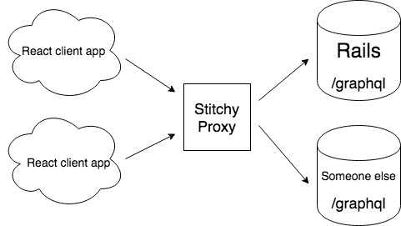
ezCater app architecture 2.0

Slide 5
Client code validation - linting FTW!

Slide 6
Fetching the backend schema

Slide 7
Server code validation - now and future
Notes:
https://www.apollographql.com/docs/engine/features/schema-history.html#github

Slide 8
Links!
Apollo Engine - https://www.apollographql.com/docs/engine/
Today’s Code - https://github.com/bjackson2/graphql-schema-talk-2018
Three ways to represent your GQL schema - https://blog.apollographql.com/three-ways-to-represent-your-graphql-schema-a41f4175100d
ezCater Jobs - https://www.ezcater.com/company/apply/

Slide 9
Thank you!

